Slide 1

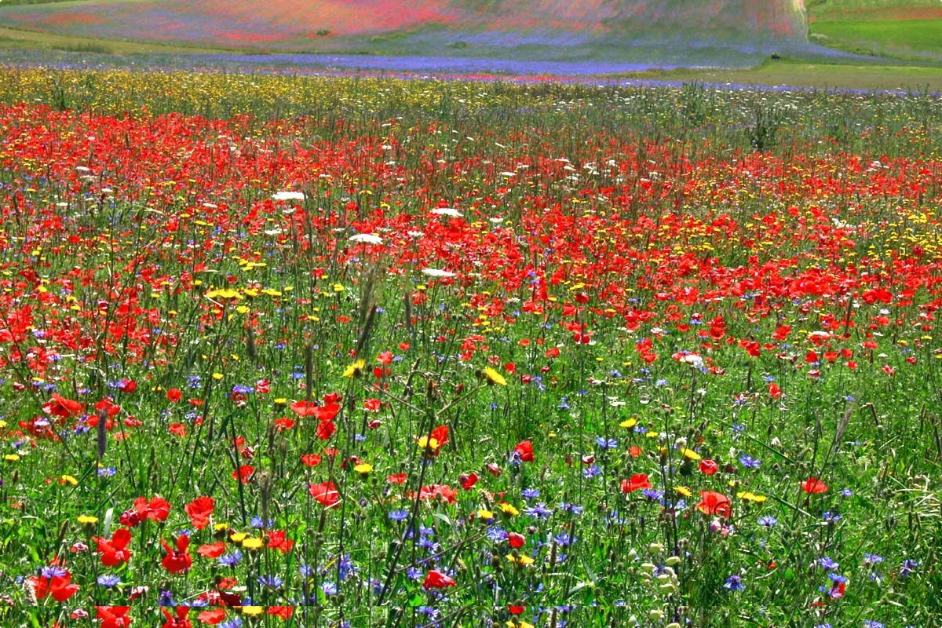
Introduction to Crop Pesticides
Crop pesticides are a crucial part of modern agriculture, playing a vital role in protecting crops from pests, diseases, and weeds. These chemical compounds help to increase crop yields, reduce food spoilage, and protect against economic losses caused by crop damage. However, the use of pesticides has also been a subject of considerable debate due to concerns about their potential environmental and health impacts.
SA
by Surya Alapaka

Slide 2
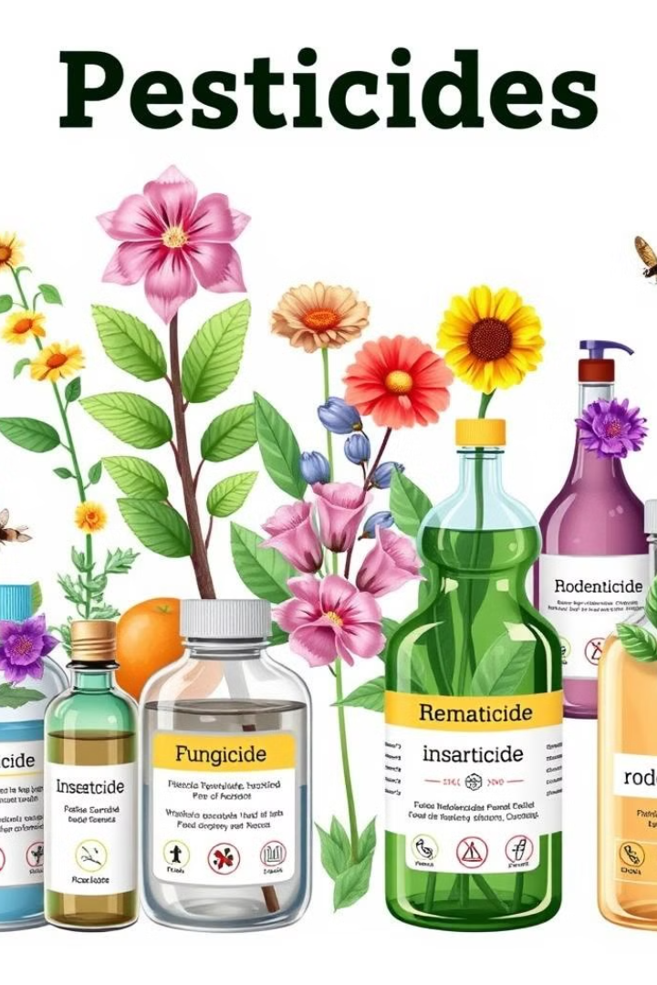
Types of Crop Pesticides
1
Insecticides
2
Fungicides
These pesticides target insects that can damage crops, such as aphids, beetles, and caterpillars. They can be classified as contact insecticides, which kill insects on contact, or systemic insecticides, which are absorbed by plants and kill insects that feed on them.
These pesticides control fungal diseases that can affect plants, leading to crop losses. They work by inhibiting the growth of fungal spores or by killing the fungus itself. Examples include fungicides used to control powdery mildew, rust, and blight.
3
Herbicides
4
Other Pesticide Types
These pesticides are used to control weeds that compete with crops for nutrients and sunlight. They can be selective herbicides, targeting specific weed species, or non-selective herbicides, killing all plants in the treated area.
Other types of pesticides include nematicides (control nematodes), rodenticides (control rodents), and molluscicides (control snails and slugs). These pesticides are used less frequently than insecticides, fungicides, and herbicides, but they are still important for protecting certain crops.

Slide 3
Organic vs. Synthetic Pesticides
Organic Pesticides
Synthetic Pesticides
Organic pesticides are derived from natural sources, such as plants, minerals, or microorganisms. They are generally considered to be less harmful to the environment and human health than synthetic pesticides. However, organic pesticides can be less effective than synthetic pesticides, and they may require more frequent application.
Synthetic pesticides are chemically produced in laboratories. They are often more effective than organic pesticides and can provide longer-lasting protection. However, synthetic pesticides can have negative impacts on the environment, including water contamination, soil degradation, and harm to beneficial insects and wildlife.

Slide 4

Factors to Consider When Choosing Pesticides
Type of Crop
Pest and Disease Prevalence
The choice of pesticide should be tailored to the specific crop being grown. Different crops are susceptible to different pests and diseases, and the type of pesticide used should be effective against the specific threats to that crop.
The level of pest and disease pressure in a particular area will influence the choice of pesticide. In areas with high pest or disease prevalence, more potent pesticides may be required, while in areas with low pressure, less potent pesticides may be sufficient.
Environmental Impact
Human Health Considerations
The potential environmental impact of the pesticide should be carefully considered. Pesticides can contaminate water sources, harm beneficial insects, and affect soil health. Choosing pesticides with minimal environmental impact is essential.
The safety of the pesticide for humans should also be considered. Pesticides can be toxic to humans, and it is important to choose pesticides that have a low risk of causing harm to workers and consumers.

Slide 5






Proper Application and Safety Measures
Read the Label
Before applying any pesticide, it is crucial to carefully read and understand the label. The label provides information about the pesticide's active ingredients, application rates, safety precautions, and environmental impacts.
Use Protective Equipment
Wear appropriate protective clothing and equipment, such as gloves, masks, and respirators, to minimize exposure to pesticides. This is especially important when mixing, loading, or applying pesticides.
Apply at the Correct Time
Apply pesticides at the correct time of day and under favorable weather conditions to maximize effectiveness and minimize environmental impacts. Avoid applying pesticides during windy or rainy conditions.
Store Properly
Store pesticides in a secure location, out of reach of children and pets. Store them in their original containers with the labels intact.

Slide 6
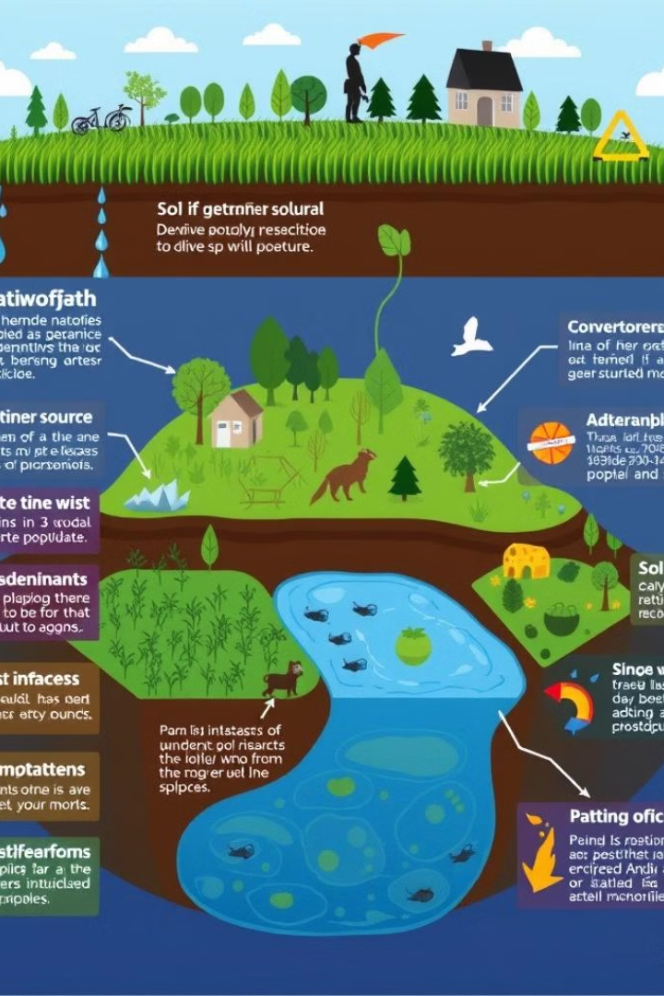
Environmental Impact of Pesticide Use
Water Contamination
Pesticides can contaminate water sources through runoff, leaching, or accidental spills. This can harm aquatic life and make the water unsafe for drinking.
Soil Degradation
Pesticides can kill beneficial soil organisms, such as earthworms and microbes, which are essential for soil health and fertility. This can lead to soil compaction, erosion, and nutrient depletion.
Harm to Wildlife
Pesticides can harm wildlife, including birds, fish, and mammals, through direct poisoning or by disrupting their food webs. This can lead to population declines and ecosystem imbalances.
Resistance Development
Overuse of pesticides can lead to the development of resistance in pest populations. This makes controlling pests more difficult and may require the use of more potent or environmentally harmful pesticides.

Slide 7
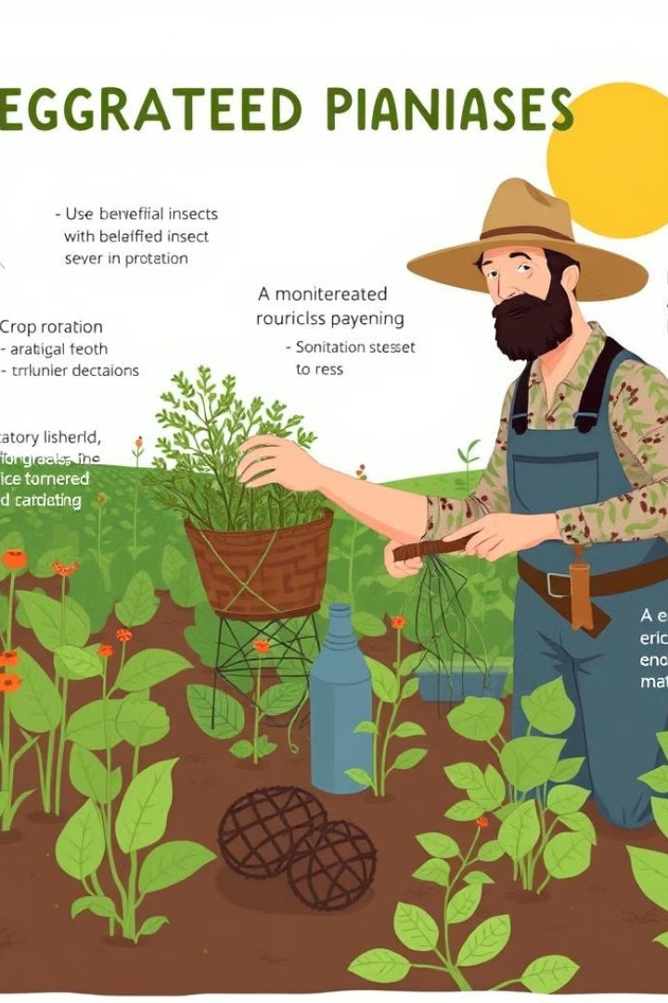
Integrated Pest Management Strategies
1
Monitoring and Identification
Regularly monitor crops for pests and diseases to identify them early and prevent outbreaks. Accurate identification of pests is essential to choose the most effective control methods.
2
Cultural Practices
Implement cultural practices that minimize pest and disease pressure, such as crop rotation, planting resistant varieties, and proper fertilization and irrigation. These practices can create a less favorable environment for pests.
3
Biological Control
Introduce beneficial insects, such as ladybugs or lacewings, that prey on pests. These natural predators can help control pest populations without the use of pesticides.
4
Chemical Control
Use pesticides only as a last resort and choose the least toxic options available. Apply pesticides strategically and at the correct time to minimize environmental impacts.

Slide 8
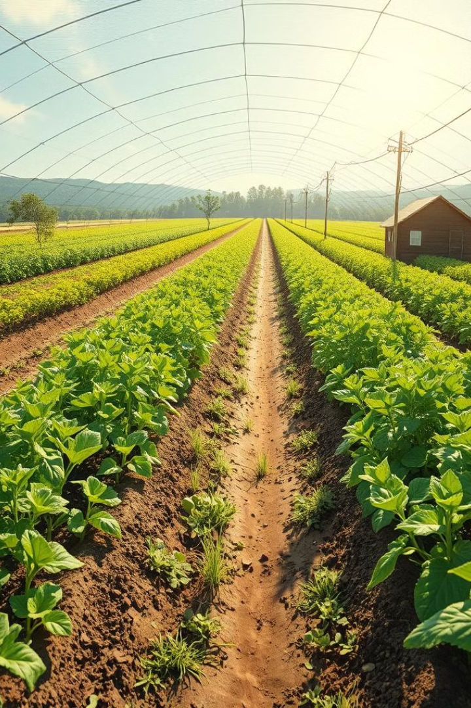
Conclusion and Recommendations
The use of pesticides in crop production is a complex issue with both benefits and drawbacks. While pesticides can help protect crops and increase yields, their environmental and health impacts must be carefully considered. By implementing integrated pest management strategies, which combine cultural, biological, and chemical control methods, we can reduce our reliance on pesticides and create a more sustainable and environmentally friendly agricultural system. It is essential to carefully weigh the risks and benefits of pesticide use, choose the most environmentally friendly options, and apply pesticides responsibly to protect human health and the environment.

